Slide 1
Lecture 13
Searching and Hashing
Ashenafi Chalchissa
Email:achalchissaguta@gmail.com
December 2017

Slide 2
Revision - Searching
Searching is a process of checking and finding an element from a list of elements.
Let A be a collection of data elements, i.e., A is a linear array of say n elements. If we want to find the presence of an element “data” in A, then we have to search for it.
The search is successful if data does appear in A and unsuccessful if otherwise.
There are several types of searching techniques; one has some advantage(s) over other.
Following are the three important searching techniques :
  Linear or Sequential Searching
  Binary Searching
  Interpolation Searching
  Fibonacci Searching

Slide 3
Interpolation Search
This method is even more efficient than binary search, if the elements are uniformly distributed (or sorted) in an array A.
Its average case complexity is O(log log N) where N is the number of keys.
Consider an array A of n elements and the elements are uniformly distributed (sorted).
Initially, as in binary search, low is set to 0 and high is set to n-1.
Now we are searching an element key in an array between A[low] and A[high].
The key would be expected to be at mid, which is an approximately position.
  mid = low + (high – low) × ((key – A[low])/(A[high] – A[low]))
Notes:
M. Hammad Waseem
Sorting Algorithms

Slide 4
Cont’d
If key is lower than A[mid], reset high to mid–1; else reset low to mid+1.
Repeat the process until the key has found or low > high.
Example: 2, 25, 35, 39, 40, 47, 50
  CASE 1: Say we are searching 50 from the array.
    Here n = 7
    Key = 50
    low = 0
    high = n – 1 = 6
    mid = 0+(6–0) × ((50–2)/(50–2))
    = 6 × (48/48) = 6
    if (key == A[mid])
    ⇒ key == A[6]
    ⇒ 50 == 50
  ⇒ key is found.

Slide 5
Cont’d
CASE 2: Say we are searching 25 from the array
  Here n = 7 Key = 25
  low = 0
  high = n – 1 = 6
  mid = 0 + (6–0) × ((25–2)/(50–2))
  = 6 × (23/48)
  = 2.875 Here we consider only the integer part of the mid
    i.e., mid = 2
  if (key == A[mid])
  ⇒ key == A[2]
  ⇒ 25 == 25
  ⇒ key is found.

Slide 6
Cont’d
CASE 3: Say we are searching 34 from the array
  Here n = 7 Key = 34
  low = 0
  high = n – 1 = 6
  mid = 0 + (6 – 0) × ((34 – 2)/(34 – 2))
  = 6 × (32/48)
  = 4
  if(key < A[mid])
  ⇒ key < A[4]
  ⇒ 34 < 40
  so reset high = mid–1
  ⇒ 3
  low = 0
  high = 3

Slide 7
Cont’d
  Since(low < high)
  mid = 0+(3–0) × ((34–2)/(39–2))
  = 3 × (32/37)
  = 2.59 Here we consider only the integer part of the mid
    i.e., mid = 2
  if (key < A[mid])
  ⇒ key < A[2]
  ⇒ 34 < 35
  so reset high = mid–1
  ⇒ 1
  low = 0
  high = 1

Slide 8
Cont’d
  Since (low < high)
  mid = 0+(1–0) × ((34–2)/(25–2))
  = 3 × (32/23)
  = 1
  here (key > A[mid])
  ⇒ key > A[1]
  ⇒ 34 > 25
  so reset low = mid+1
  ⇒ 2
  low = 2
  high = 1
  Since (low > high)
  DISPLAY “ The key is not in the array”
  STOP

Slide 9
Algorithm
1. Input a sorted array of n elements and the key to be searched
2. Initialize low = 0 and high = n – 1
3. Repeat the steps 4 through 7 until if(low < high)
4. Mid = low + (high – low) × ((key – A[low]) / (A[high] – A[low]))
5. If(key < A[mid])
  (a) high = mid–1
6. Elseif (key > A[mid])
  (a) low = mid + 1
7. Else
  (a) DISPLAY “ The key is not in the array”
  (b) STOP
8. STOP

Slide 10
Implementation
class interpolation
{
int Key;
int Low,High,Mid;
public:
void InterSearch(int*,int);
};
//This function will search the element using interpolation search
void interpolation::InterSearch(int *Arr,int No)
{
int Key;
//Assigning the pointer low and high
Low=0;High=No–1;
//Inputting the element to be searched
cout<<“\n\nEnter the Number to be searched = ”;
cin>>Key;

Slide 11
Cont’d
while(Low < High)
{
//Finding the Mid position of the array to be searched
Mid=Low+(High–Low)*((Key–Arr[Low])/(Arr[High]–Arr[Low]));
if (Key < Arr[Mid])
//Re-initializing the high pointer if the
//key is greater than the mid value
High=Mid–1;
else if (Key > Arr[Mid])
//Re initializing the low pointer if the
//key is less than the mid value
Low=Mid+1;
else
{
//if the key value is equal to the mid value

Slide 12
Cont’d
//of the array, the key is found
cout<<“\nThe key “<<Key<<” is found at the location ”<<Mid;
return;
}
};
cout<<“\n\nThe Key “<<Key<<” is NOT found”;
}
void main()
{
int *a,n,*b;
interpolation Ob;
clrscr();
cout<<“\n\nEnter the number of elements : ”;
cin>>n;
a=new int[n];
b=a;

Slide 13
Cont’d
//Input the elements in the array
for (int i=0;i<n;i++)
{
cout<<“\nEnter the “<<i<<” element : ”;
cin>>*a;
a++;
}
//calling the InterSearch function using objects
Ob.InterSearch(b,n);
cout<<“\n\nPress any key to continue...”;
getch();
}

Slide 14
Fibonacci Search
Fibonacci Search – Reading Assignment

Slide 15
Hashing
Hashing is a technique where we can compute the location of the desired record in order to retrieve it in a single access (or comparison).
Suppose we were to come up with a “magic function” that, given a value to search for, would tell us exactly where in the array to look.
  If it’s in that location, it’s in the array.
  If it’s not in that location, it’s not in the array.
This function would have no other purpose.
If we look at the function’s inputs and outputs, they probably won’t “make sense”.
This function is called a hash function because it “makes hash” of its inputs.

Slide 16
Cont’d
Key-value pairs are stored in a fixed size table called a hash table (symbol table).
  A hash table is partitioned into many buckets.
  Each bucket has many slots.
  Each slot holds one record.
  A hash function h(x) transforms the identifier (key) into an address in the hash table
The process of implementing this hash table (symbol table) is called hashing which is both conceptually simple and very efficient.
Search tree methods: key comparisons
  Time complexity: O(size) or O(log n)
Hashing methods: hash functions
  Expected time: O(1)

Slide 17
Cont’d
Following are the most popular Distribution - Independent hash functions :
  Division method
    H(k) = k (mod m)
  Mid Square method
    H(k) = k² and the middle digits will be selected as a key.
  Folding method.
    H(k) = k1 + k2 + ...... + kr

Slide 18
Cont’d
s slots
0
1
s-1
 |  | . . .
. . . | . . . |  | . . .
 |  | . . .
0
1
b buckets
b-1

Slide 19
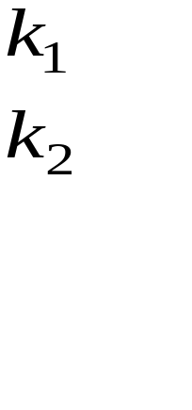
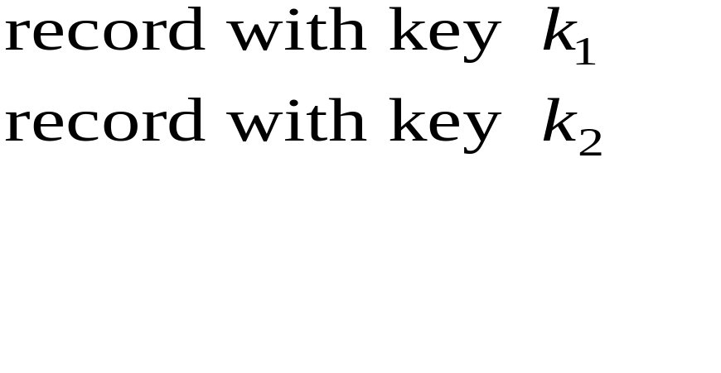
Cont’d
Observation: We can store a set very easily if we can use its keys as array indices:
A:
e.g. SEARCH(A,k)
return A[k]

Slide 20
Cont’d
Problem: usually, the number of possible keys is far larger than the number of keys actually stored, or even than available memory. (E.g., strings.)
Idea of hashing: use a function h to map keys into a smaller set of indices, say the integers 0…m. This function is called a hash function.
E.g. h(k) = position of k’s first letter in the alphabet.

Slide 21
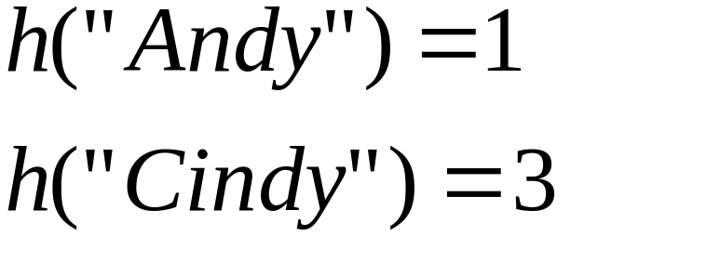
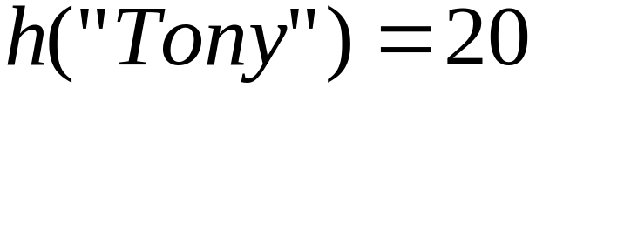
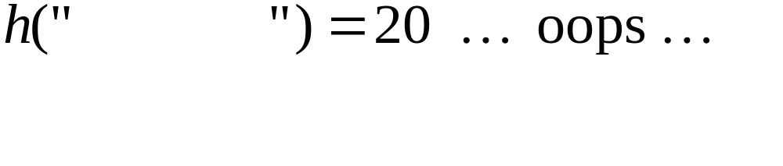
T:1
Andy
2
3
Cindy
20
Tony
Thomas
Problem: Collisions. They are inevitable if there are more possible key values than table slots.

Slide 22
Cont’d
Uses an array table[0:b-1].
  Each position of this array is a bucket.
  A bucket can normally hold only one dictionary pair.
Uses a hash function h that converts each key k into an index in the range [0, b-1].
Every dictionary pair (key, element) is stored in its home bucket table[h[key]].

Slide 23
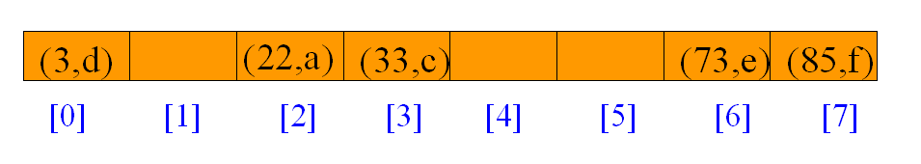
Cont’d
Pairs are: (22,a), (33,c), (3,d), (73,e), (85,f).
Hash table is table[0:7], b = 8.
Hash function is key (mod 11).

Slide 24
Cont’d
Where does (26,g) go?
Keys that have the same home bucket are synonyms.
  22 and 26 are synonyms with respect to the hash function that is in use.
The bucket for (26,g) is already occupied.

Slide 25
Collisions
When two values hash to the same array location, this is called a collision.
Collisions are normally treated as “first come, first served” - the first value that hashes to the location gets it.
We have to find something to do with the second and subsequent values that hash to this same location.

Slide 26
Resolving Collisions
Let’s assume for now that our hash function is OK, and deal with the collision resolution problem.
Two groups of solutions:
  Store the colliding key in the hash-table array. (“Closed hashing”)
  Store it somewhere else. (“Open hashing”)

Slide 27
Closed Hashing
Store colliders in the hash table array itself:
(“Closed hashing” or “Open addressing”)
T: 1 Andy
2
3 Cindy
20 Tony
21
Insert Thomas
20 Tony
21 Thomas

Slide 28
Example: Insertion I
Suppose you want to add seagull to this hash table
Also suppose:
  hashCode(seagull) = 143
  table[143] is not empty
  table[143] != seagull
  table[144] is not empty
  table[144] != seagull
  table[145] is empty
Therefore, put seagull at location 145
. . .
141
142
143
144
145
146
147
148
. . .
robin
sparrow
hawk
seagull
bluejay
owl

Slide 29
Searching I
Suppose you want to look up seagull in this hash table
Also suppose:
  hashCode(seagull) = 143
  table[143] is not empty
  table[143] != seagull
  table[144] is not empty
  table[144] != seagull
  table[145] is not empty
  table[145] == seagull !
We found seagull at location 145
. . .
141
142
143
144
145
146
147
148
. . .
robin
sparrow
hawk
seagull
bluejay
owl

Slide 30
Searching II
Suppose you want to look up cow in this hash table
Also suppose:
  hashCode(cow) = 144
  table[144] is not empty
  table[144] != cow
  table[145] is not empty
  table[145] != cow
  table[146] is empty
If cow were in the table, we should have found it by now
Therefore, it isn’t here
. . .
141
142
143
144
145
146
147
148
. . .
robin
sparrow
hawk
seagull
bluejay
owl

Slide 31
Insertion II
Suppose you want to add hawk to this hash table
Also suppose
  hashCode(hawk) = 143
  table[143] is not empty
  table[143] != hawk
  table[144] is not empty
  table[144] == hawk
hawk is already in the table, so do nothing
. . .
141
142
143
144
145
146
147
148
. . .
robin
sparrow
hawk
seagull
bluejay
owl

Slide 32
Insertion III
Suppose:
  You want to add cardinal to this hash table
  hashCode(cardinal) = 147
  The last location is 148
  147 and 148 are occupied
Solution:
  Treat the table as circular; after 148 comes 0
  Hence, cardinal goes in location 0 (or 1, or 2, or ...)
. . .
141
142
143
144
145
146
147
148
robin
sparrow
hawk
seagull
bluejay
owl

Slide 33
Closed Hashing…
Advantage:
  No extra storage for lists
Disadvantages:
  Harder to program
  Harder to analyze
  Table can overflow
  Performance is worse

Slide 34
Open Hashing
Put all the keys that hash to the same index onto a linked list. Each T[i] called a bucket or slot.
T: 1 Andy
2
3 Cindy
20 Thomas Tony

Slide 35
Example: Insertion
The previous solutions used closed hashing: all entries went into a “flat” (unstructured) array.
Another solution is to make each array location the header of a linked list of values that hash to that location.
. . .
141
142
143
144
145
146
147
148
. . .
robin
sparrow
seagull
hawk
bluejay
owl

Slide 36
Application of Hashing
Hashing is vastly more prevalent than trees for in-memory storage.
Examples:
  UNIX shell command cache
  “arrays” in Icon, Awk, Tcl, Perl, etc.
  Compiler symbol tables
  Filenames on CD-ROM
  And more…

